Slide 1

1. Introduction to R and Data Manipulation with Dplyr
Jonathan Hersh, PhD (Chapman Argyros School of Business)
4/8/22

Slide 2
Section 1: Outline
R Projects
Data Analysis
Loading data
Glimpse to view
Pipe operator
slice() to select rows
arrange() to order data frame
select() to choose variables
rename() to rename variables
filter() to select rows matching characteristics
mutate() to create new variables
group_by() and summarize() to create group

Slide 3
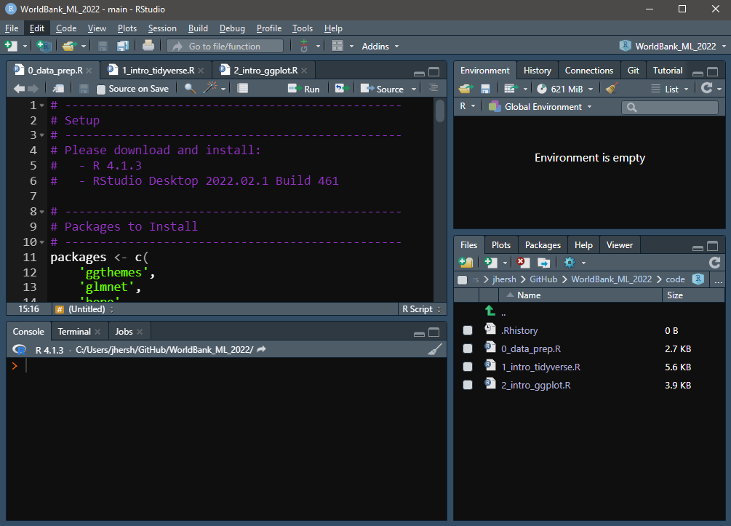
Rstudio Projects
Rstudio Projects are environments for your code
They make your life easier, especially across teams and platforms
Always use Rstudio Projects!

Slide 4
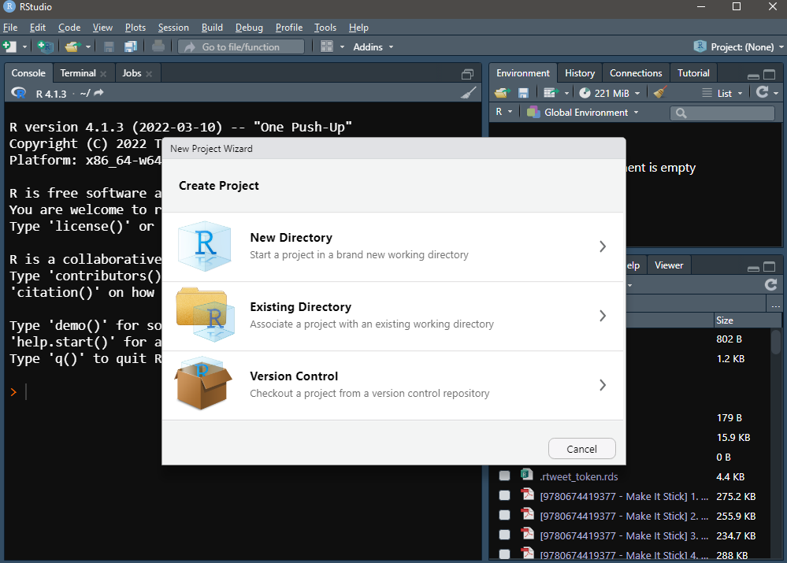
Rstudio Projects
I recommend you create a new project in your github repo folder
Select file -> new project

Slide 5
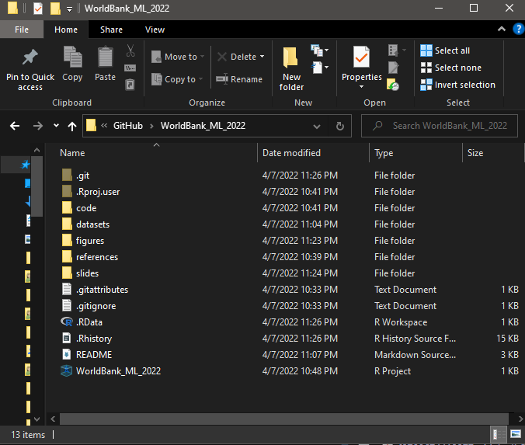
Rstudio Projects
This creates an .Rproj file you should click and open whenever you want to run code for this class

Slide 6
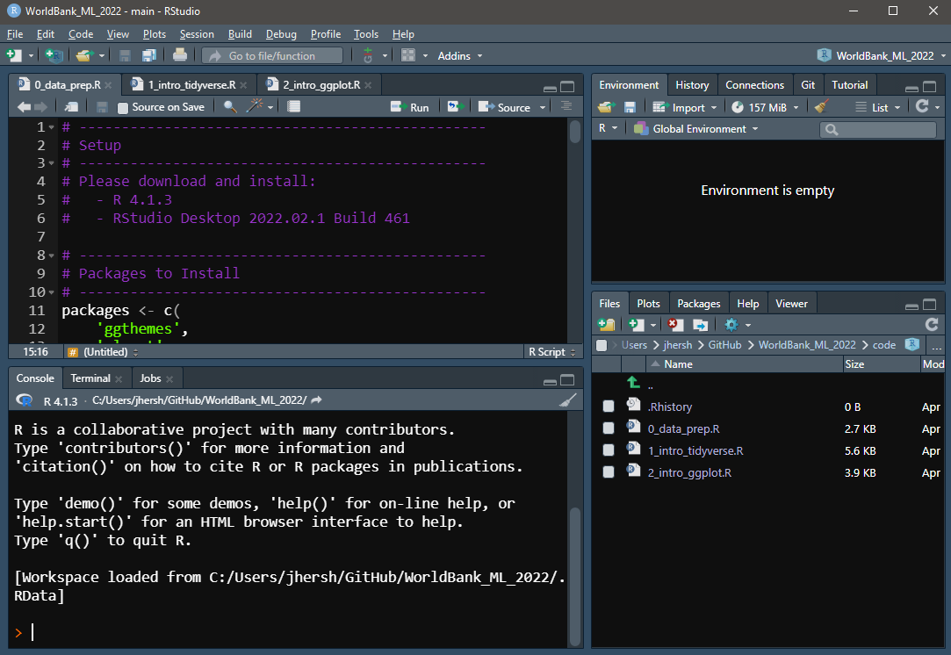
Rstudio Projects
You should see your project name in the top right and the “root directory” of the project in the bottom right
All links to files, datasets are relative to this root folder

Slide 7
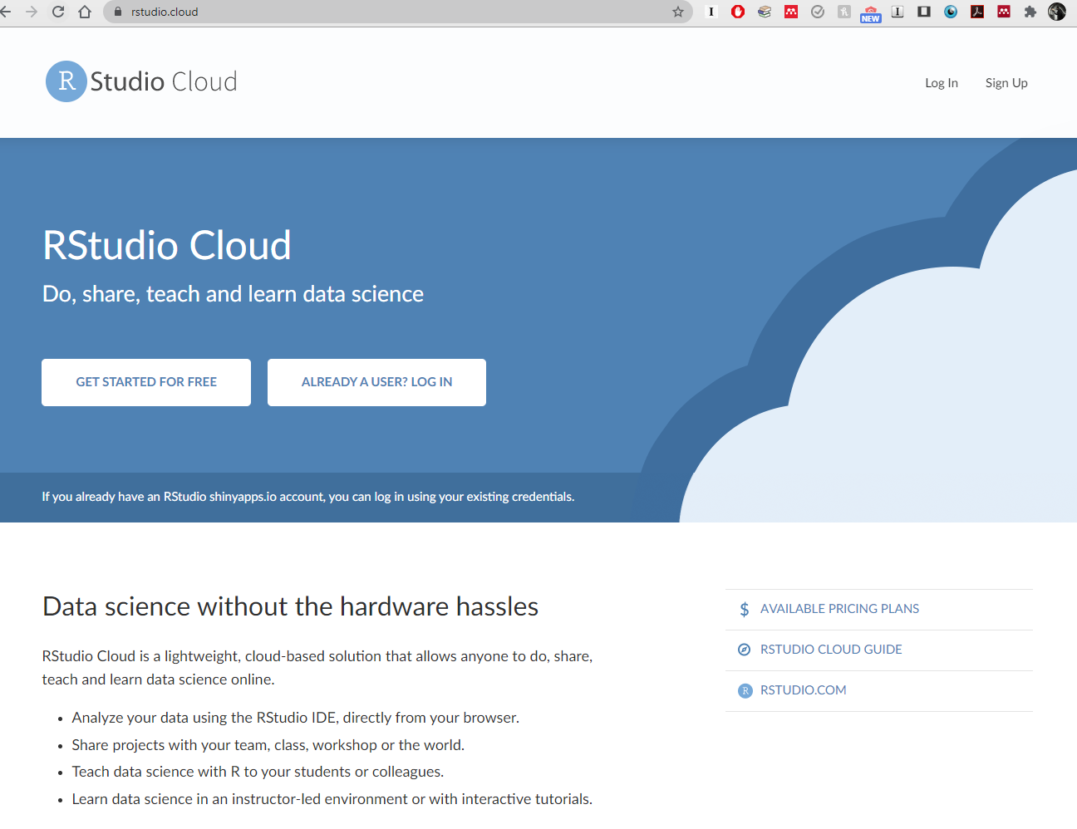
R Studio Cloud
Go to rstudio.cloud if your version of R is ever not working

Slide 8
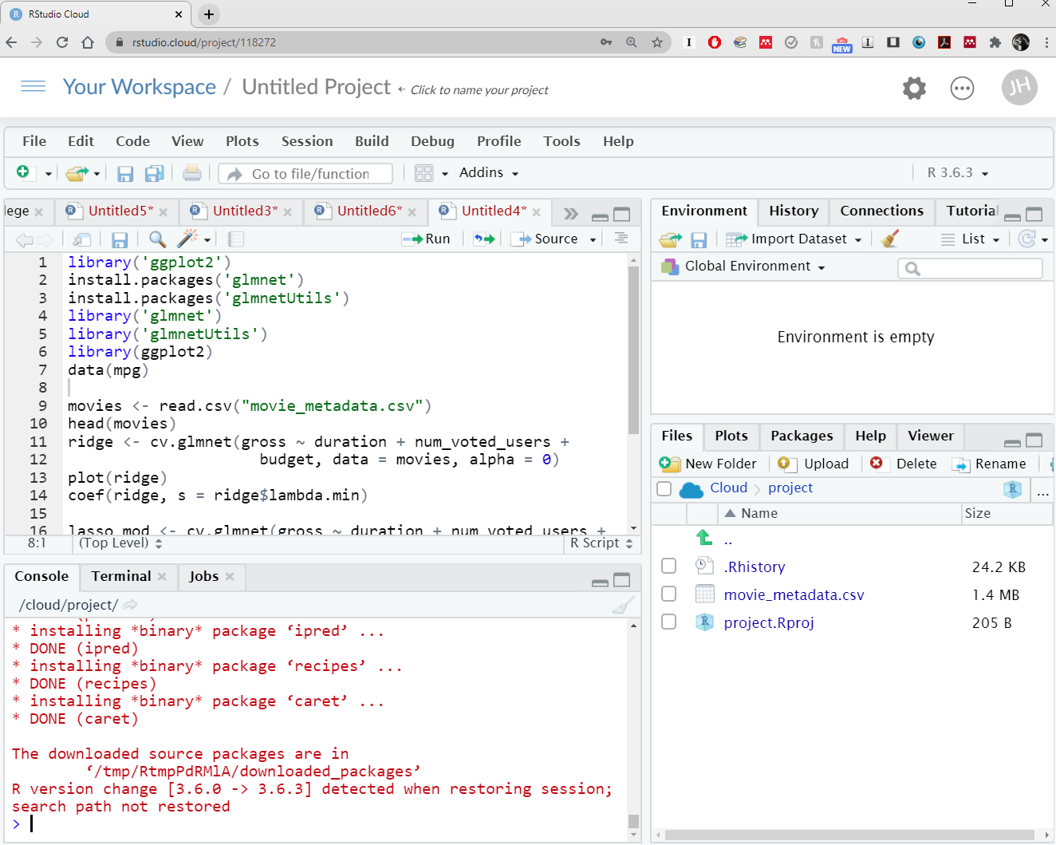
R Studio Cloud
R Studio Cloud is a full featured version of R in your browser!

Slide 9
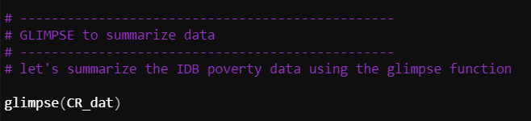
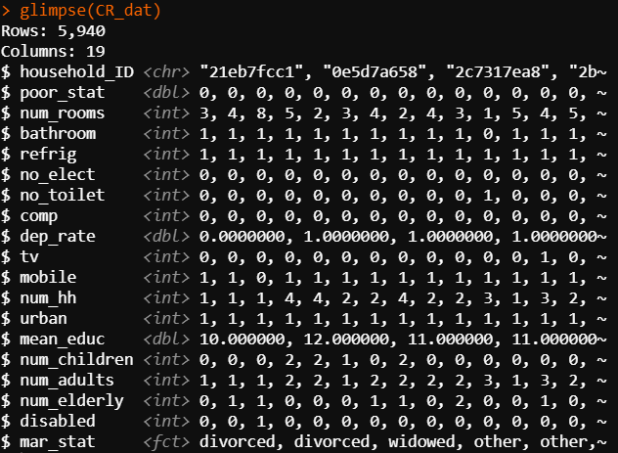
glimpse() to summarize the data

Slide 10
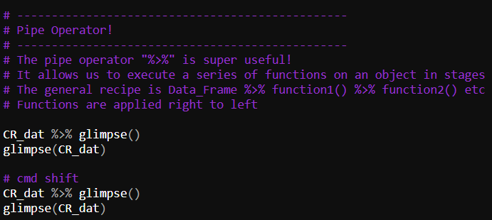
pipe operator %>%

Slide 11
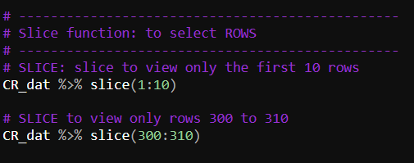
slice() to select rows

Slide 12
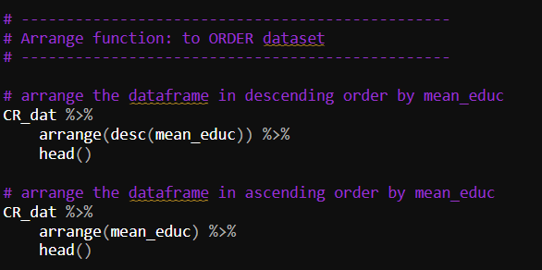
arrange() to order dataset

Slide 13
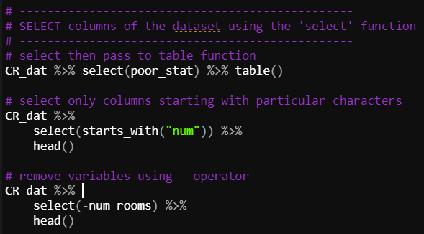
select() to select columns in a dataset

Slide 14
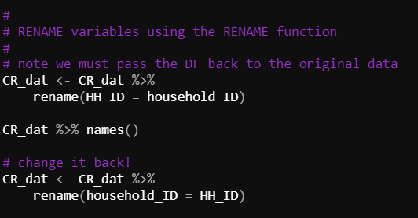
rename() to rename variables in a dataset

Slide 15
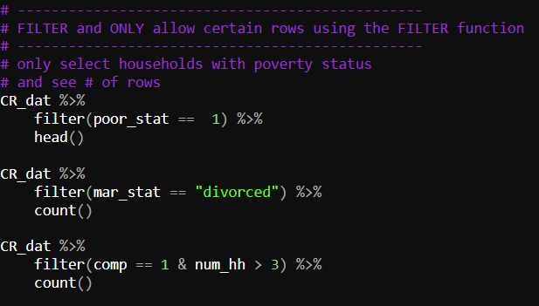
filter() to remove rows you don’t want

Slide 16
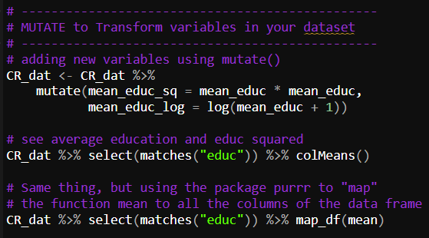
mutate() to create new variables

Slide 17
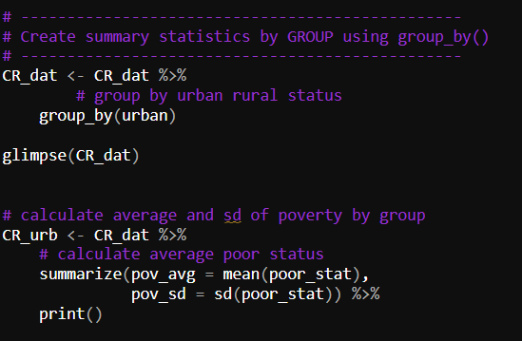
group_by() and summarize() to create group variables

Slide 18
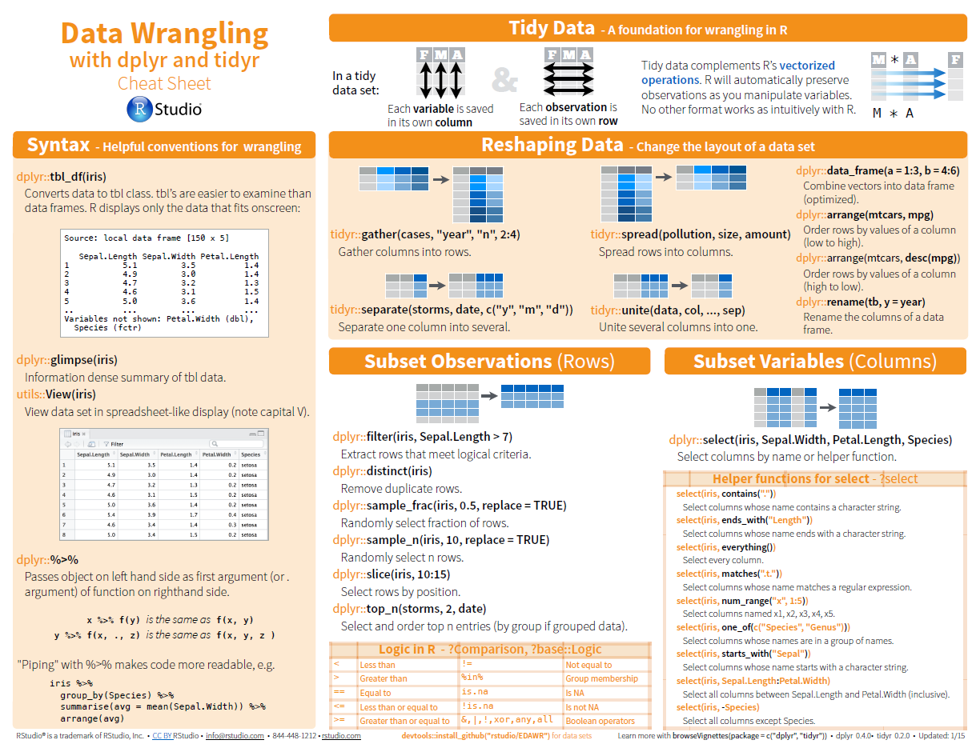
https://www.rstudio.com/resources/cheatsheets/

